Slide 1

Trends in data Science jobs
Shivantika Bisen, Nick Carson, Mamatha Etikyala ,Tamara Hundich, Swati Kallepalli
11.6.2023

Slide 2

Data Science provides ample job opportunities with access to remote work and higher salary wages based on experience.

Slide 3
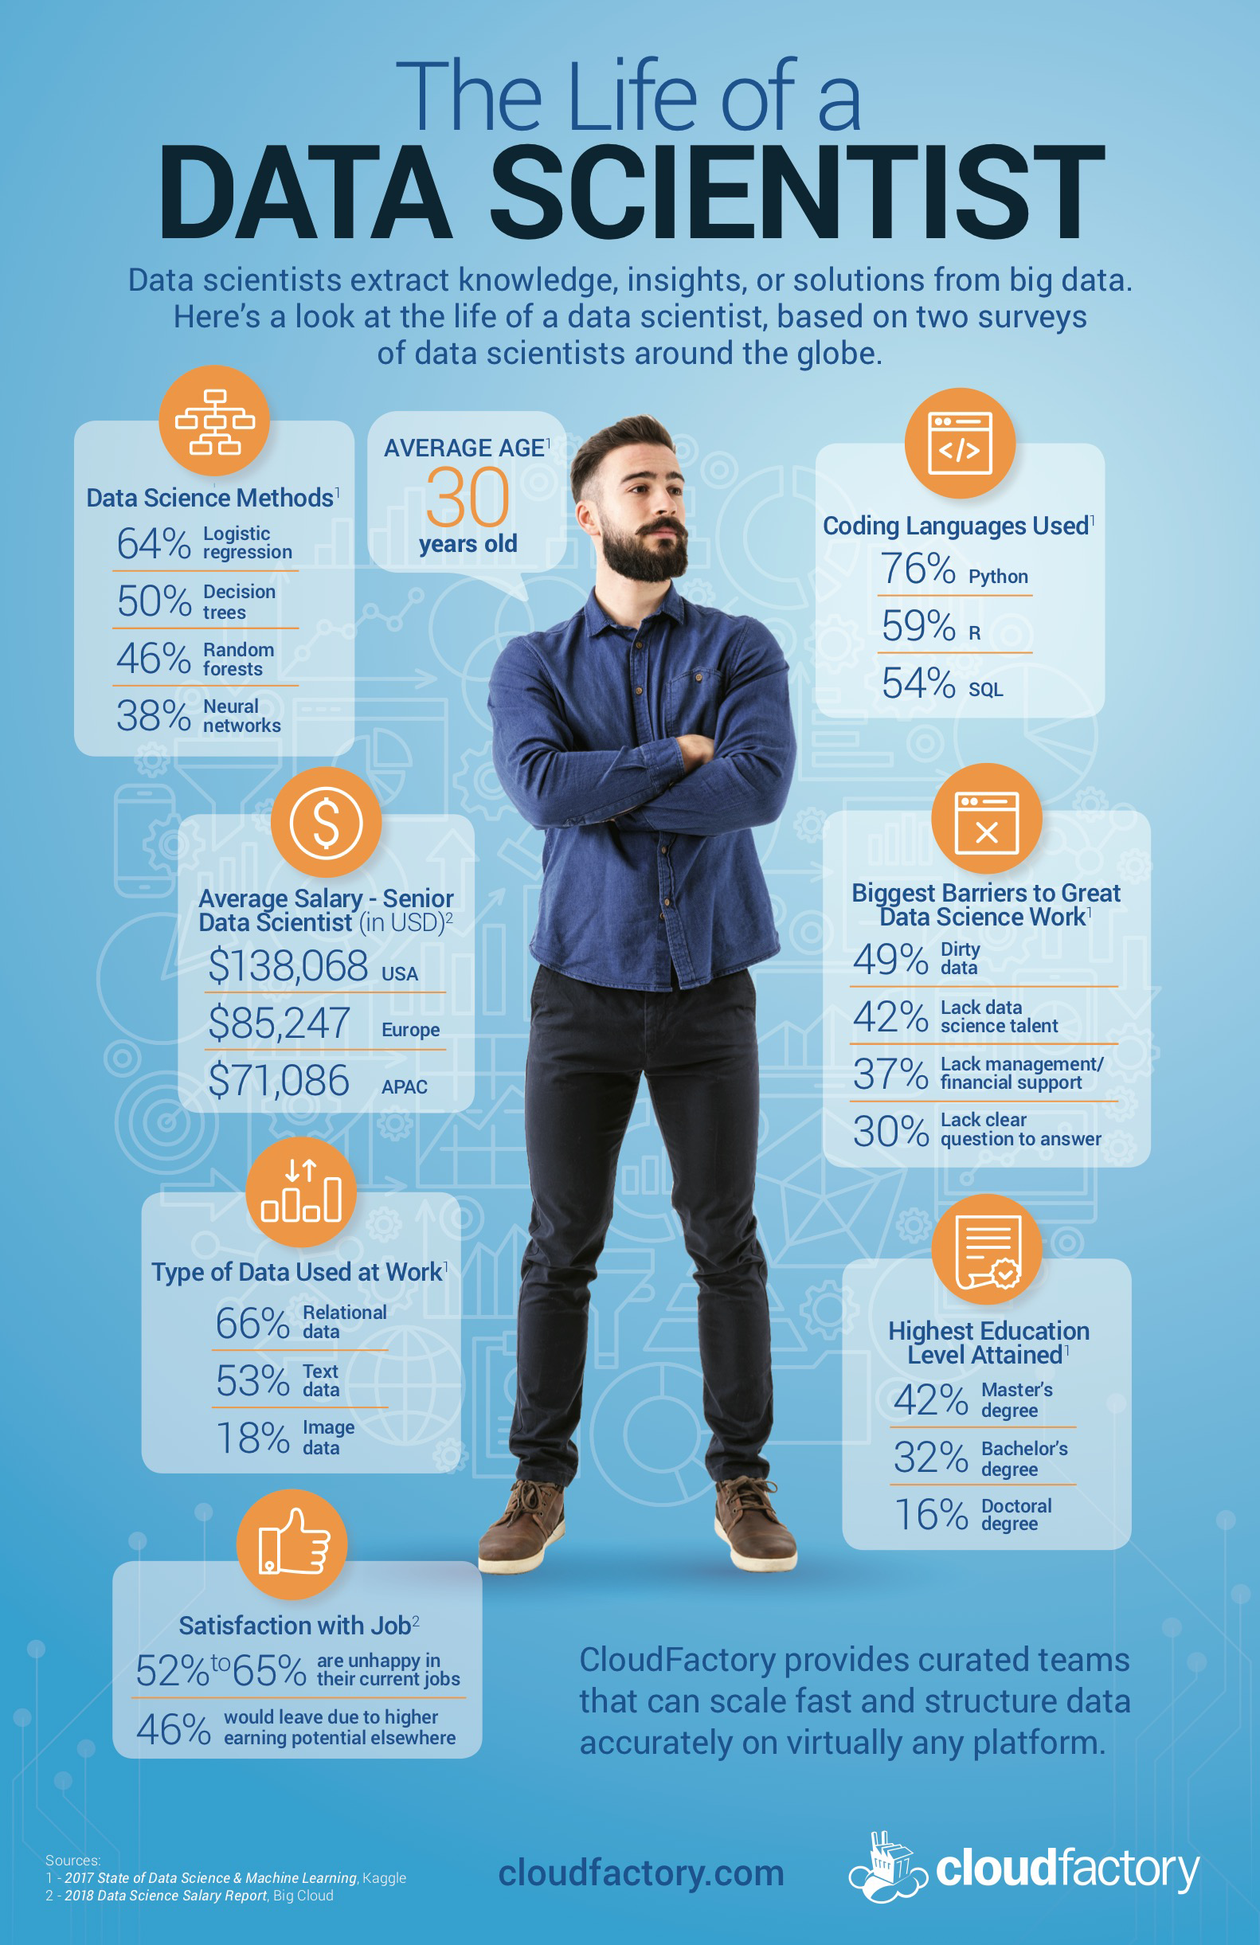
INTRODUCTION
Data Science Salary Breakdown
Jobs by country - Shivantika Bisen
Top 10 countries with map- Tamara Hundich
Growth in Data Science Jobs- Nick Carson
Salary by company size- Mamatha Etikyala
Remote vs in office salary- Swati Kallepalli
Office location vs. Resident Locations- Swati Kallepalli

Slide 4

How many jobs are available?

Slide 5
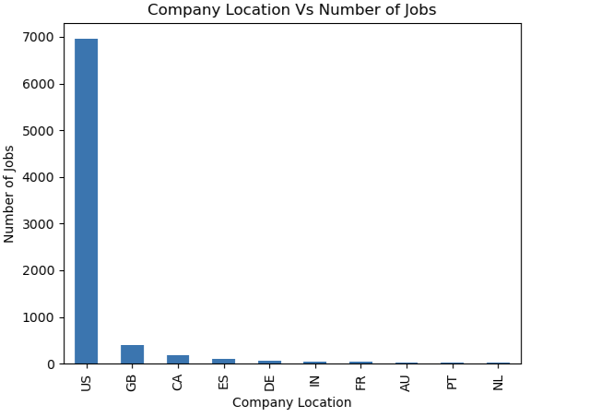
JOBS BY cOUNTRY
US=United States GB=Great Britain CA=Canada ES=Spain DE=Germany IN=India FR=France AU=Australia PT=Portugal NL=Netherlands

Slide 6
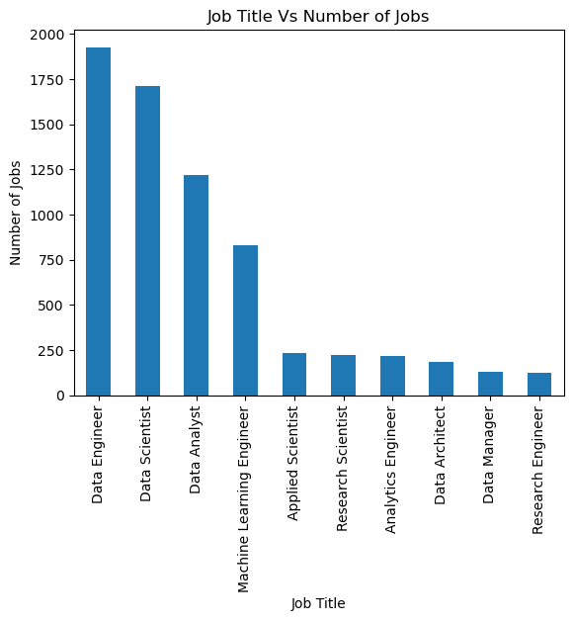

Slide 7
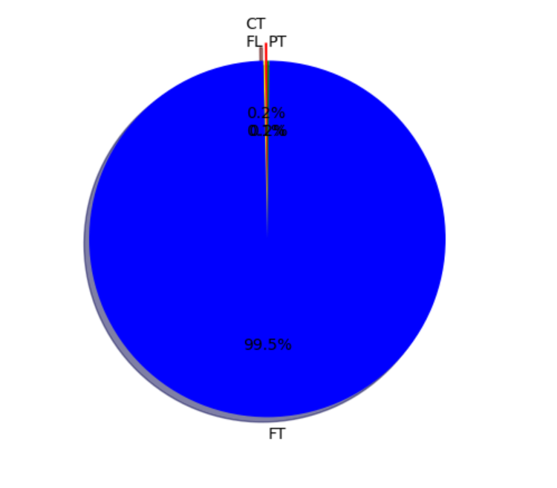
Remote work vs employment type
FT= Full-time
PT= Part-time
CT= Contract
FL= Freelance

Slide 8
What are the top countries for jobs and their salaries?

Slide 9
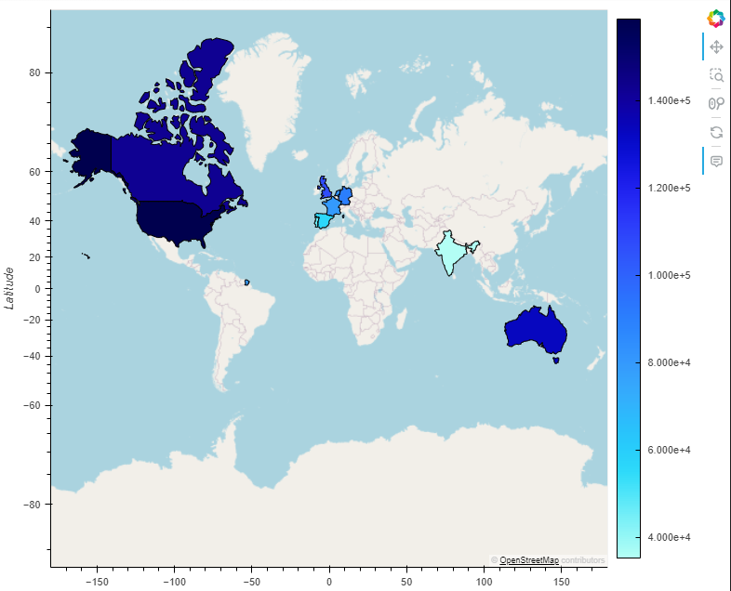
TOP cOUNTRIES

Slide 10
TOP cOUNTRIES based on employment
Country | Population | Total # of Jobs | Average Data Science Salary | Average Country Salary
1. United States | 328,239,523 | 6,956 | $158,613.88 | $95,100
2. Great Britian/United Kingdom | 66,834,405 | 403 | $106,626.74 | $86,820
3. Canada | 37,589,262 | 181 | $142,539.52 | $88,240
4. Spain | 47,076,781 | 108 | $56,418.70 | $34,500
5. Germany | 83,132,799 | 72 | $90,456.67 | $48,580
6. India | 1,366,417,754 | 51 | $35,292.24 | $46,130
7. France | 67,059,887 | 47 | $79,699.07 | $52,530
8. Australia | 25,364,307 | 23 | $133,035.04 | $58,840
9. Portugal | 10,269,417 | 21 | $46,347.48 | $35,010
10. Netherlands | 17,332,850 | 18 | $83,141.72 | $62,160

Slide 11

Is there growth for data science jobs?

Slide 12
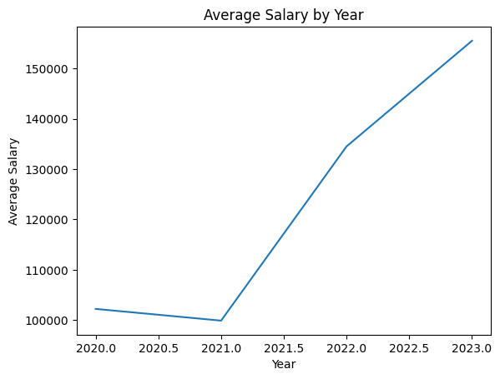
GROWTH IN DATA SCIENCE JOBS
Hypothesis: Salaries are increasing by 5% YoY to keep up with inflation.
There is an average increase of 25% over the past 3 years.
The largest increase was between 2021 to 2022.
As more companies leverage data analytics to propel their businesses forward, it creates a greater demand for the jobs driving salaries up.

Slide 13
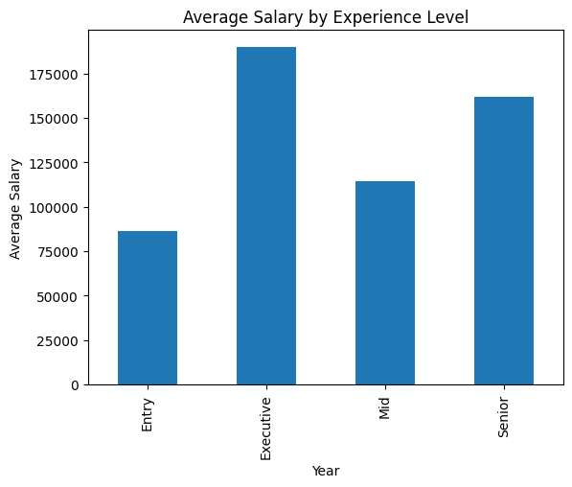
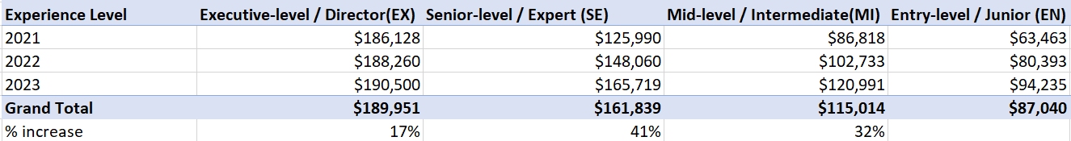
GROWTH IN dATA sCIENCE jObS
Hypothesis: As you move to the next experience level you get a 10% raise.
Average increase between each experience level is 30% and drastically drops off when you move from the senior level to the executive/director level.
The growth drop off could be driven by executive stock options.

Slide 14

What is the expected salary?

Slide 15
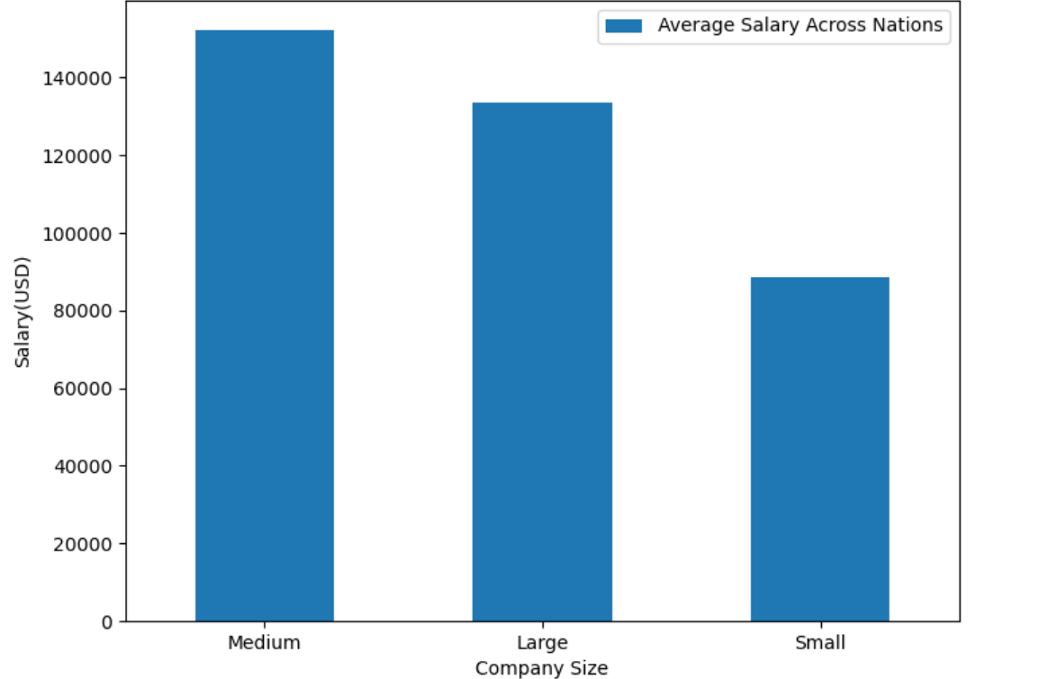
Average Salary by COmpany Size

Slide 16
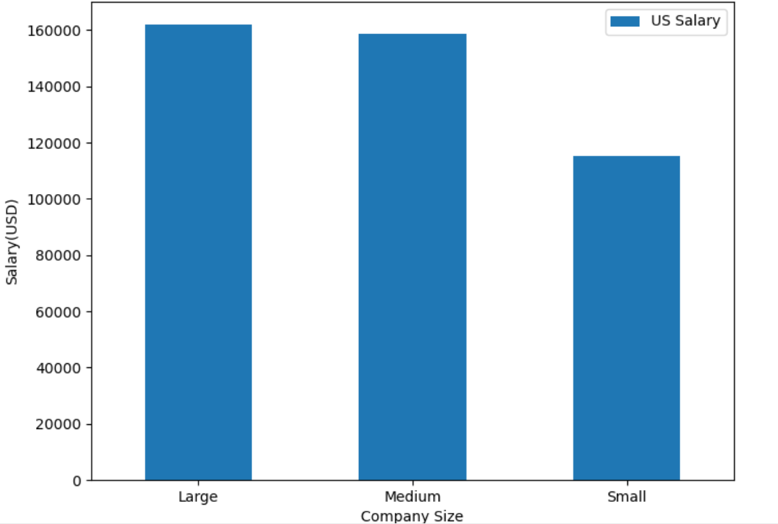

Slide 17
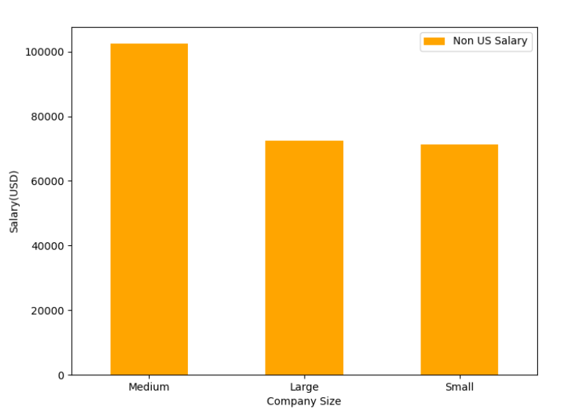

Slide 18
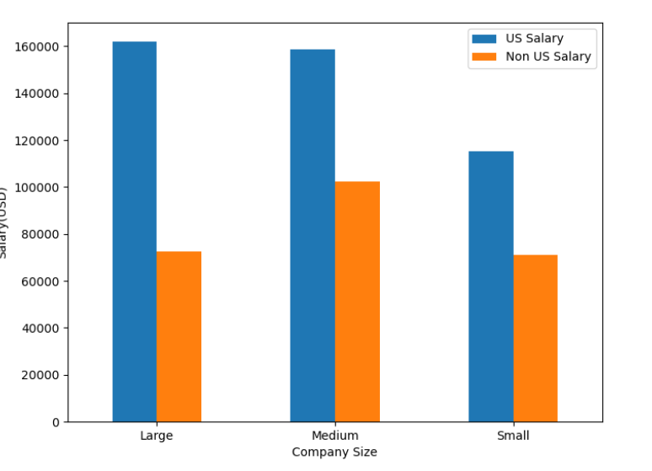
Average Salary by COmpany Size Us vs. Other Countries

Slide 19
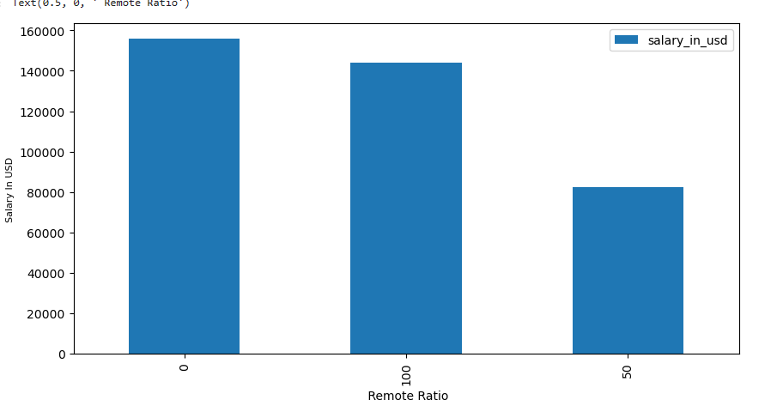
AVG sALARY for rEMOTE,Hybrid & In office jOBS
EFFECT OF REMOTE WORK ON PAY
From our dataset, this has been divided into three categories: 0 No remote work (less than 20%), 50 Partially remote 100 & Fully remote (more than 80%).
Salary For No Remote is High up to 150000USD. While salary for Partial Remote is Showing Low.

Slide 20
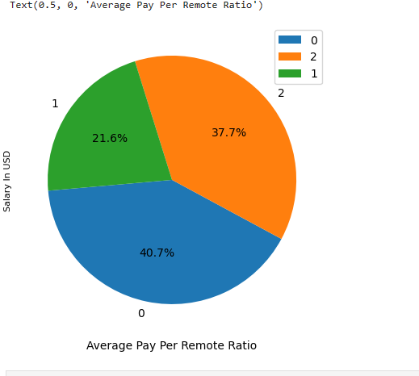
Pie chart for Average Pay Per Remote Ratio
40.7% of Data Science jobs are works not remote
37.7 % are doing fully remote
21.6% are working partially remote work.

Slide 21
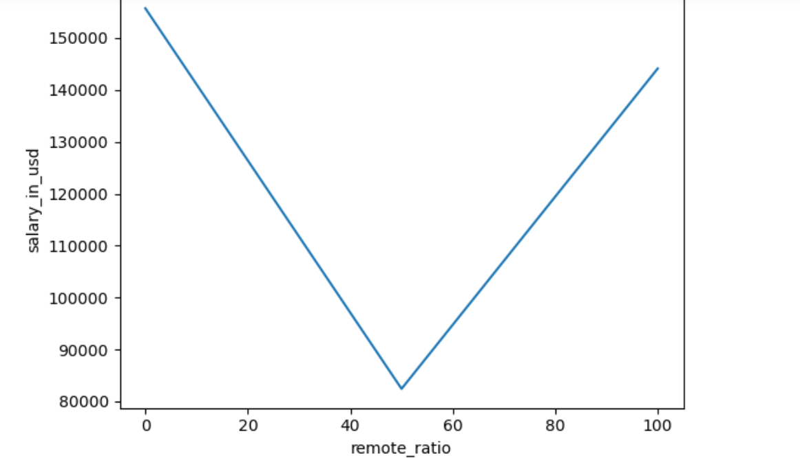
average salary as per remote ratio Shown using Line Graph

Slide 22
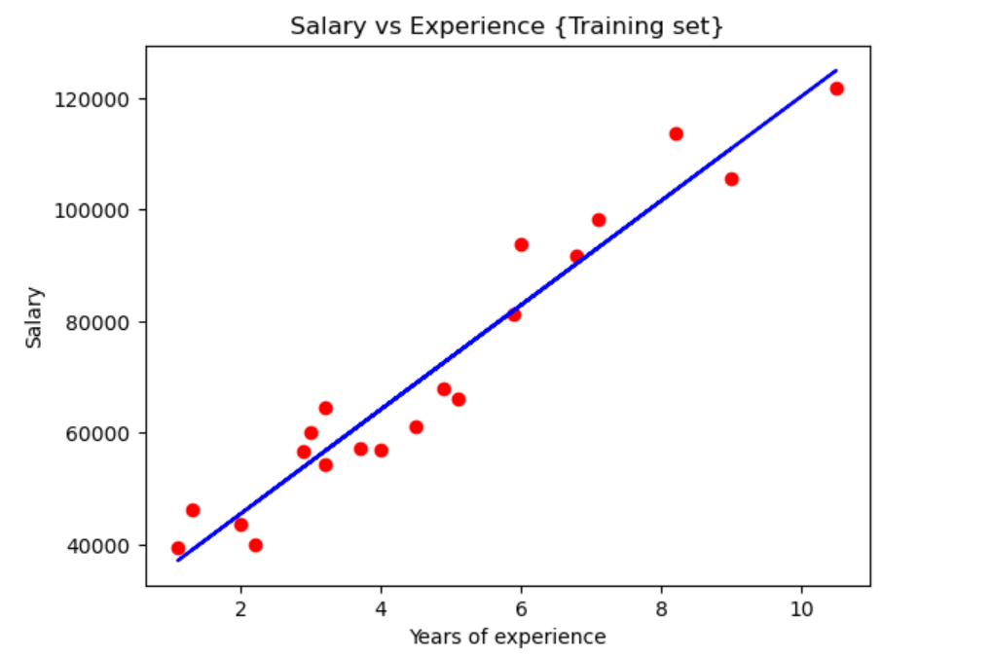
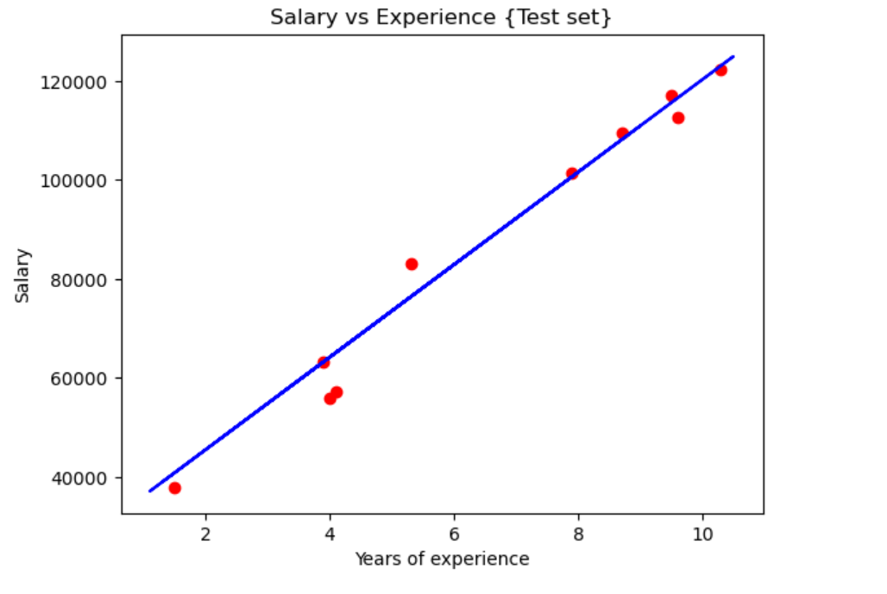
Linear Regression Shown by Salary& Years of experience for training &Test Set
The dataset contains two columns namely: “YearsExperience” and “Salary”. In this case the model will be using the YearsExperience to predict the Salary. Hence, YearsExperience is the independent variable and Salary is the dependent variable.
It is divided in to test set & Training set.
Getting the final linear regression equation with the values of the coefficients

Slide 23

Is there a correlation between remote work and employee residence?

Slide 24
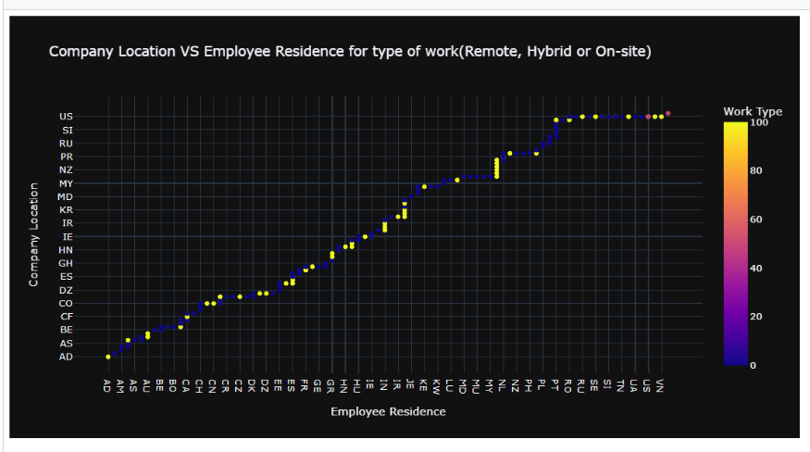
COMPANY lOCATION vS eMPLOYEE rESIDENCE sCATTER pLOT

Slide 25

Summary
Ample job opportunities
There are multiple job opportunities available, with the most being in the United States.
There is room for growth
With more experience, comes higher salary ranges.
increased salary
On-site locations had higher salaries than those working remotely.
Remote work
99% of full-time workers were able to find remote work
Employee location
Most employees resided in the country in which the company was located and this was due to most jobs were in-office setting.
Company size effects salary
The medium and larger companies had a larger salary pay for their employees. However, the United States paid higher salaries for their employees compared to other countries.

Slide 26
Questions?

Slide 27
Resources
https://ai-jobs.net/salaries/download/
ISO - ISO 3166 — Country Codes
Kaggle- Salary data, country and population data for countries
Vecteezy- some pictures

